Slide 1
Employee Attrition Prediction
Name : Rahul Kumar
Roll :B24BS2271
Subject : PRP

Slide 2
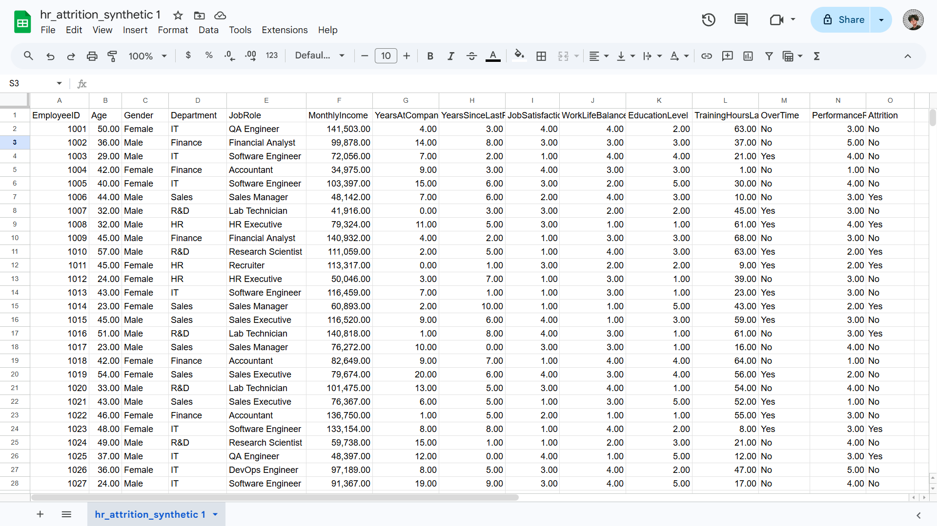

Slide 3
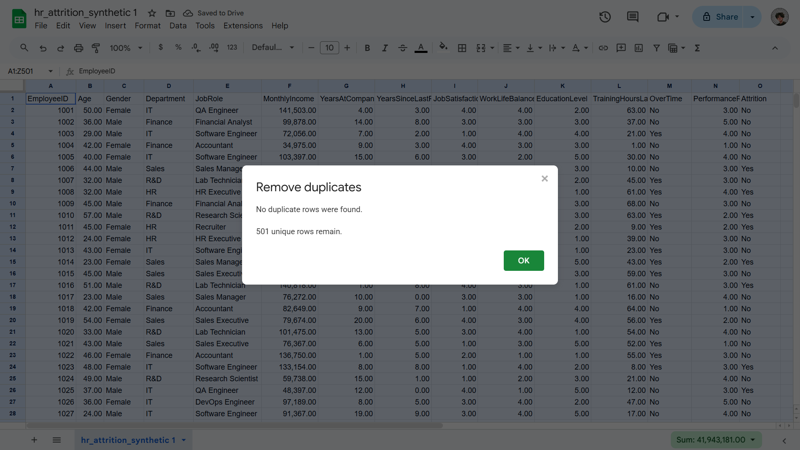

Slide 4
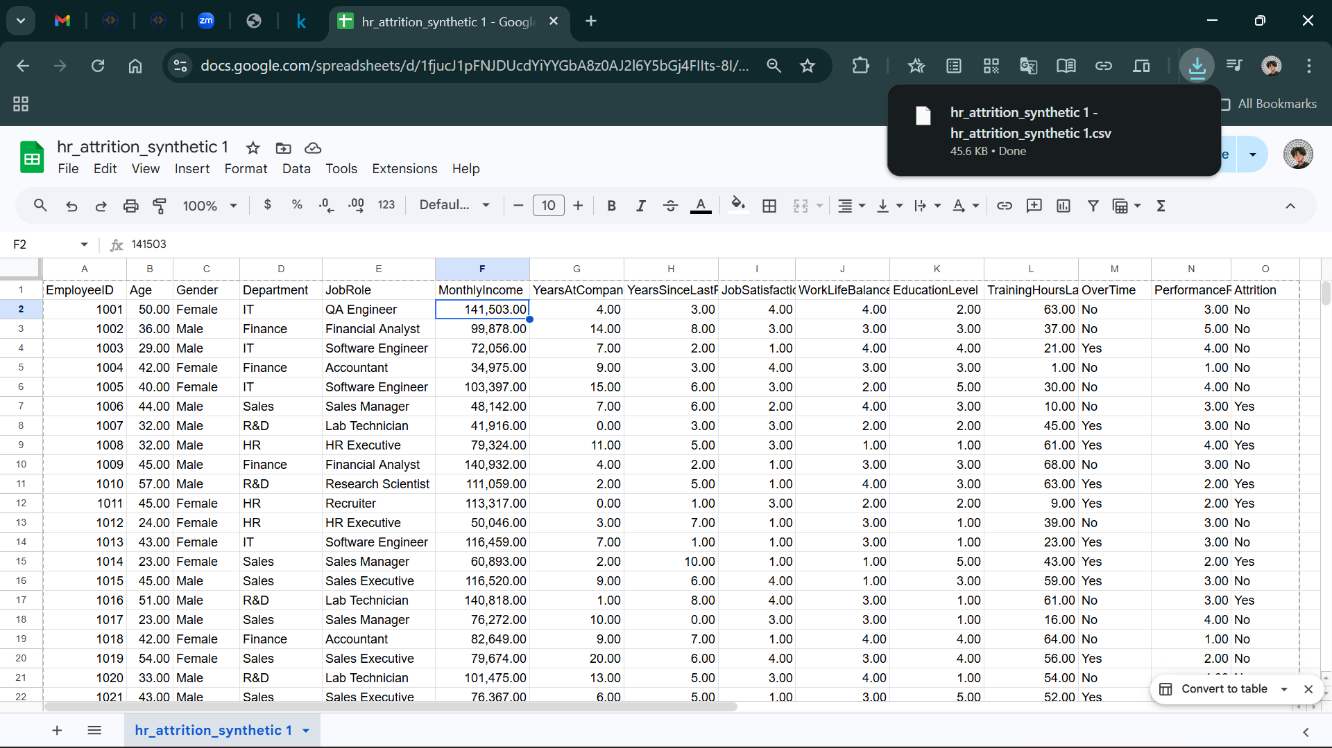

Slide 5
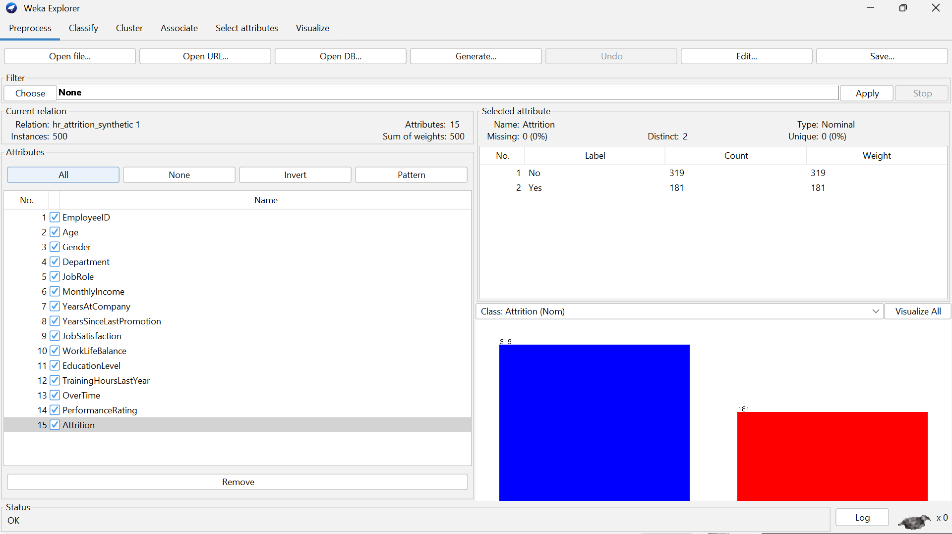

Slide 6
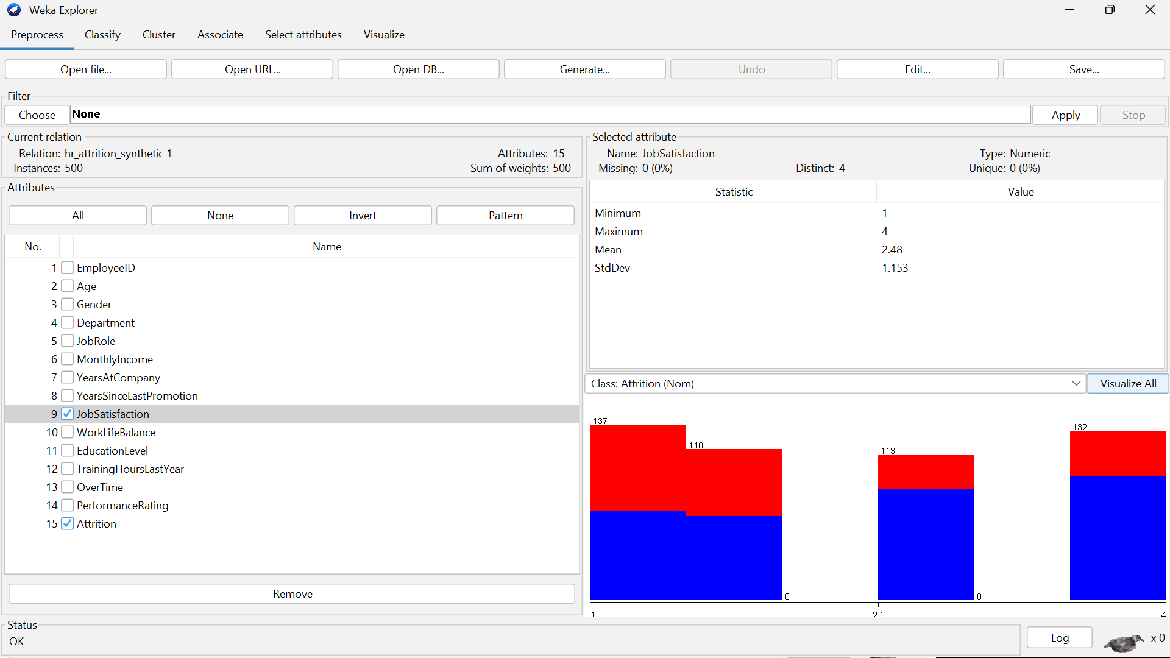

Slide 7
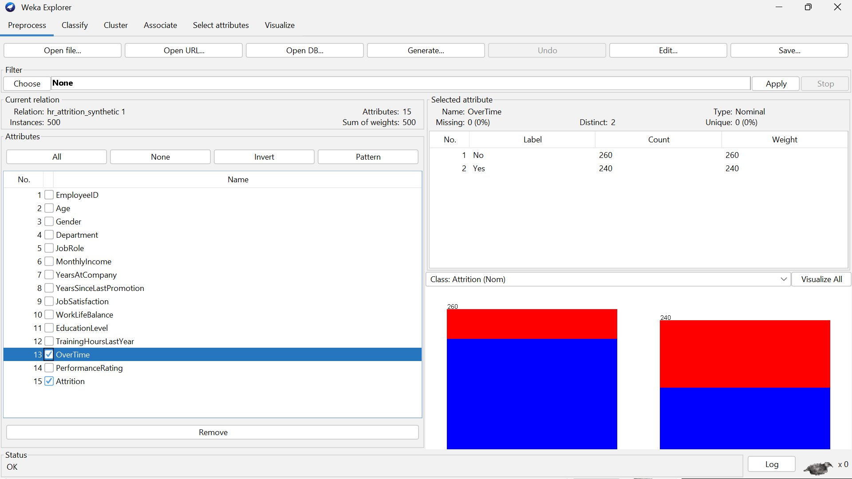

Slide 8
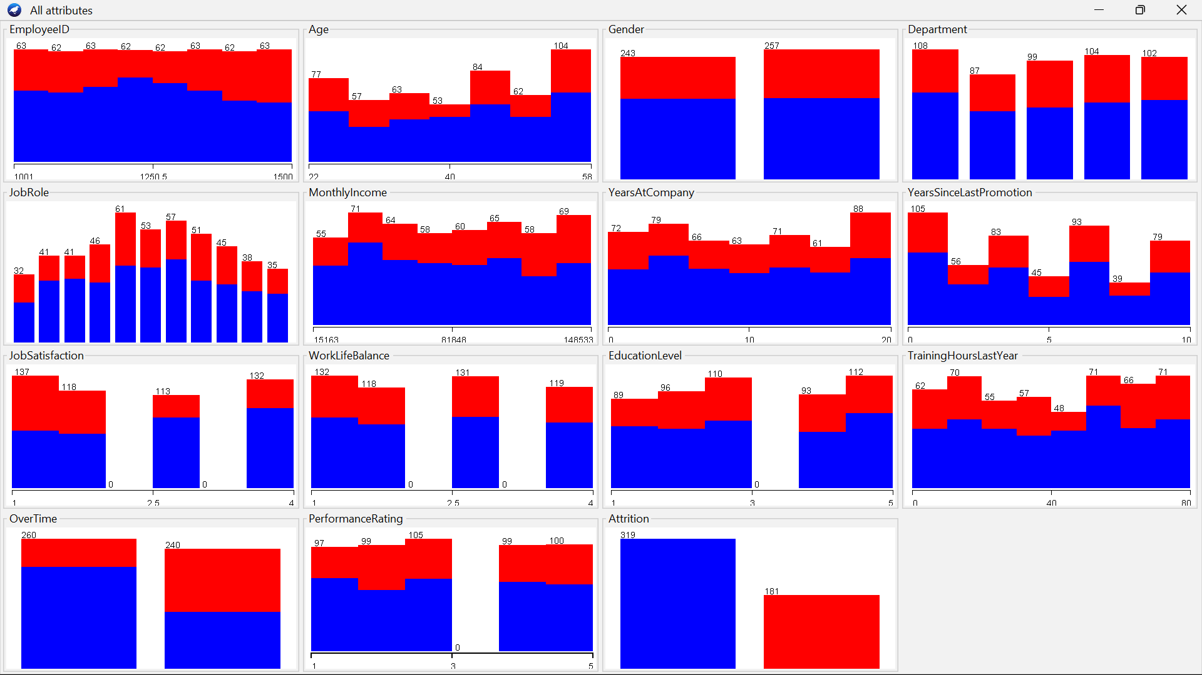

Slide 9
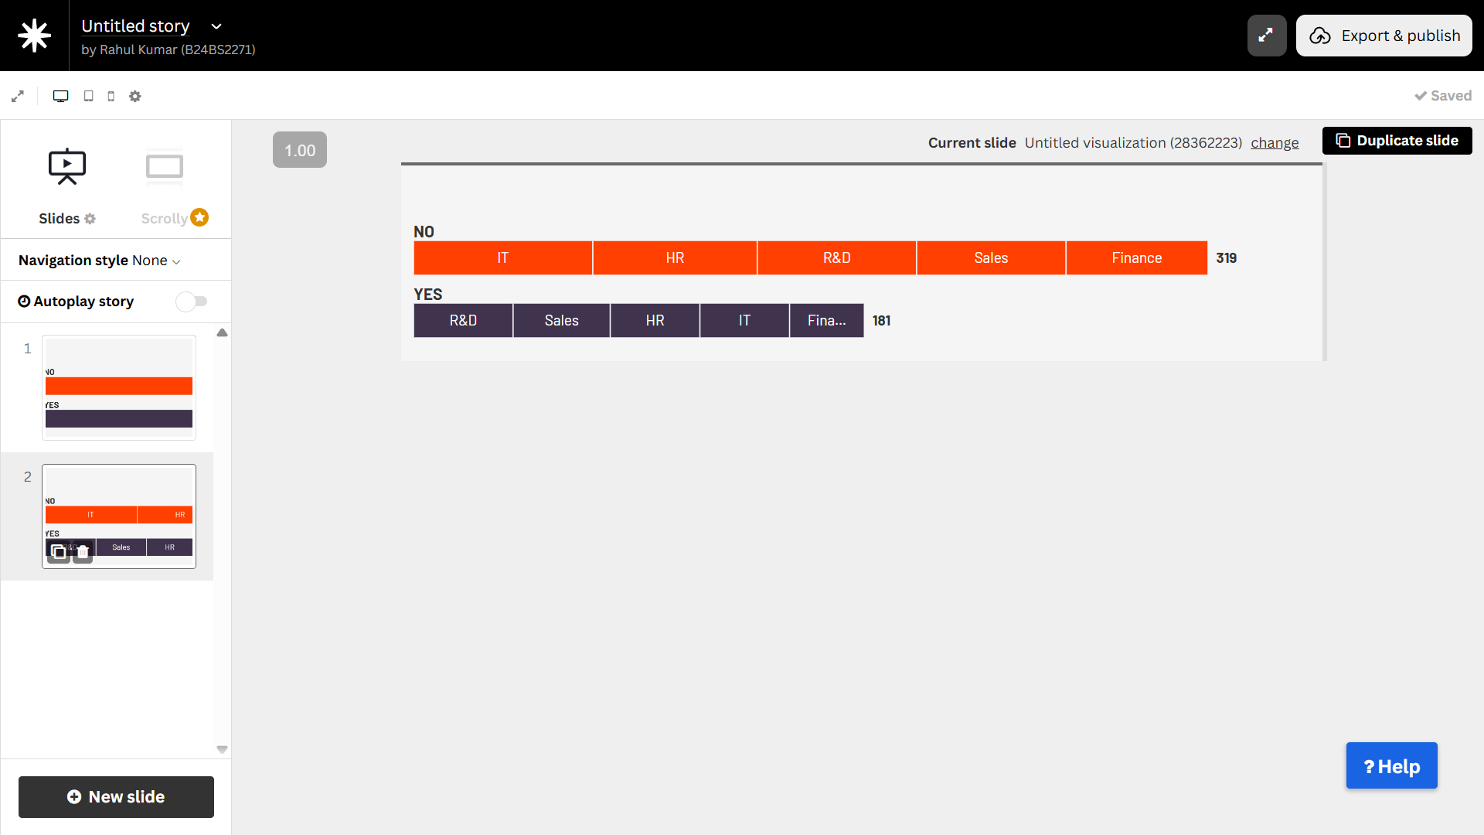

Slide 10
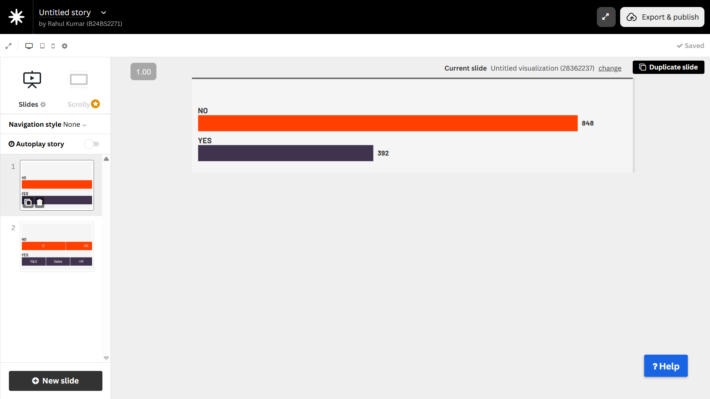

Slide 11
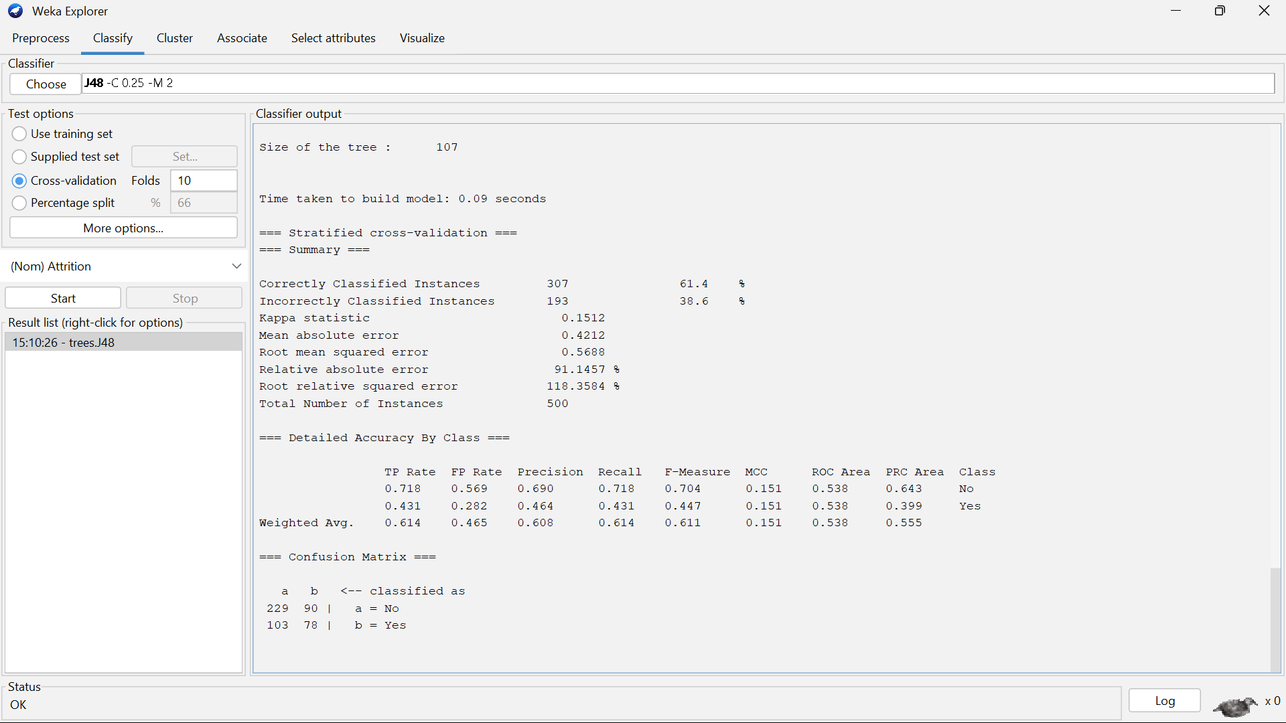

Slide 12
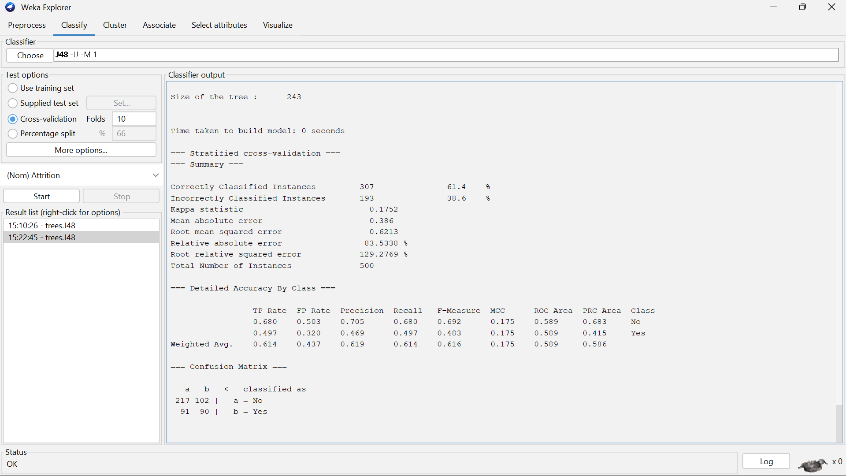

Slide 13
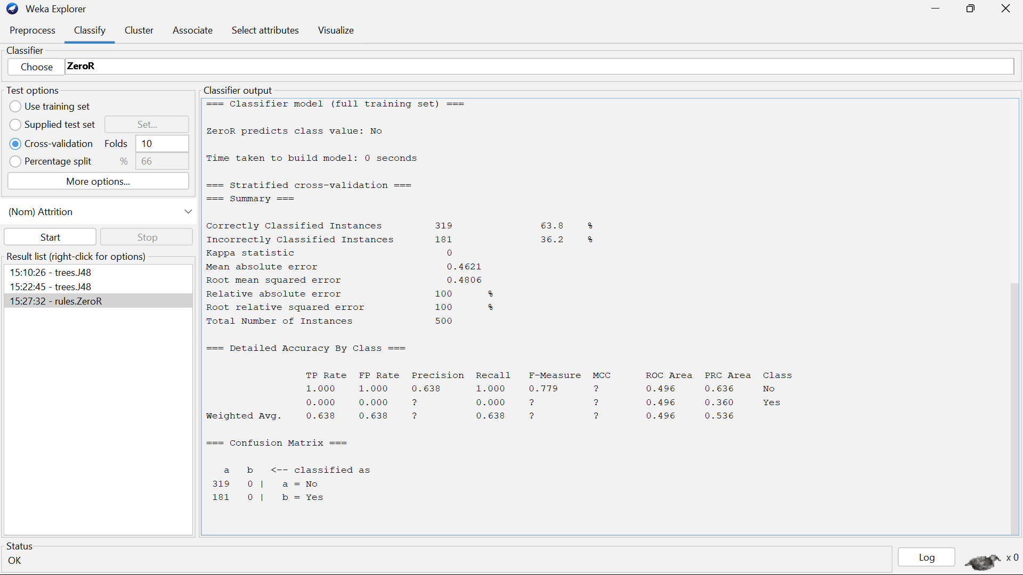

Slide 14
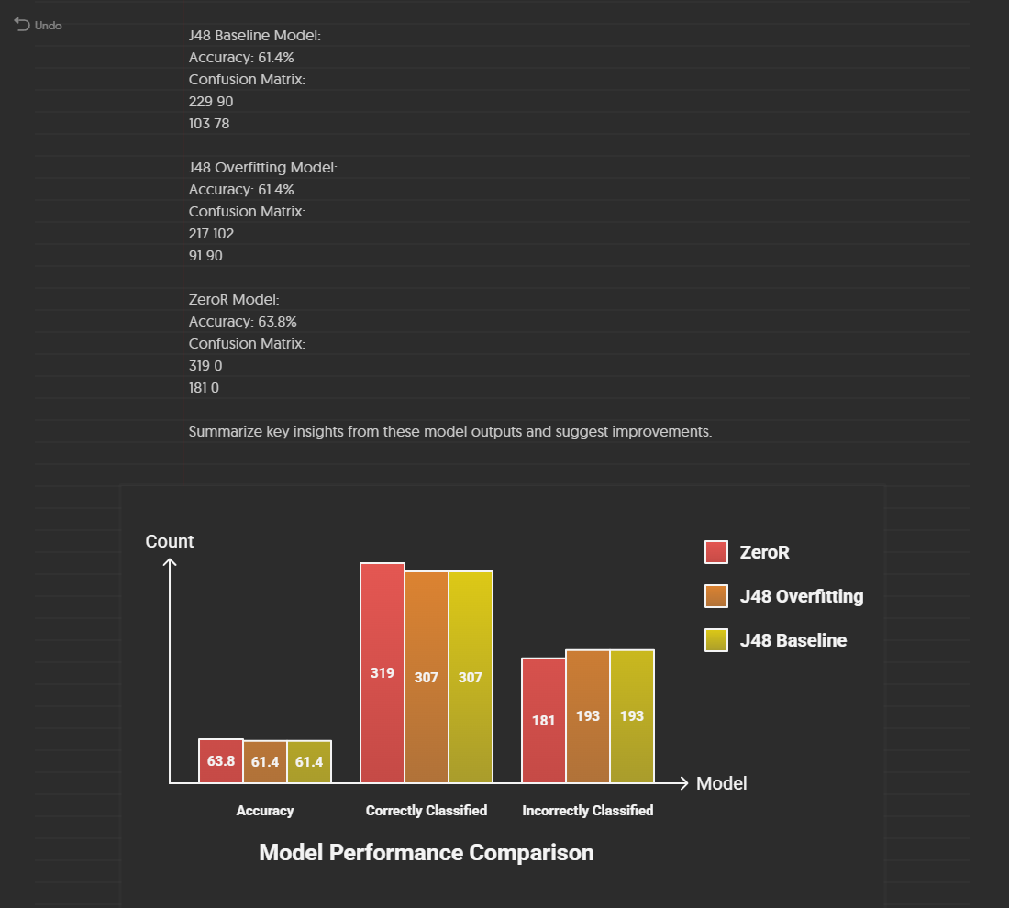

Slide 15
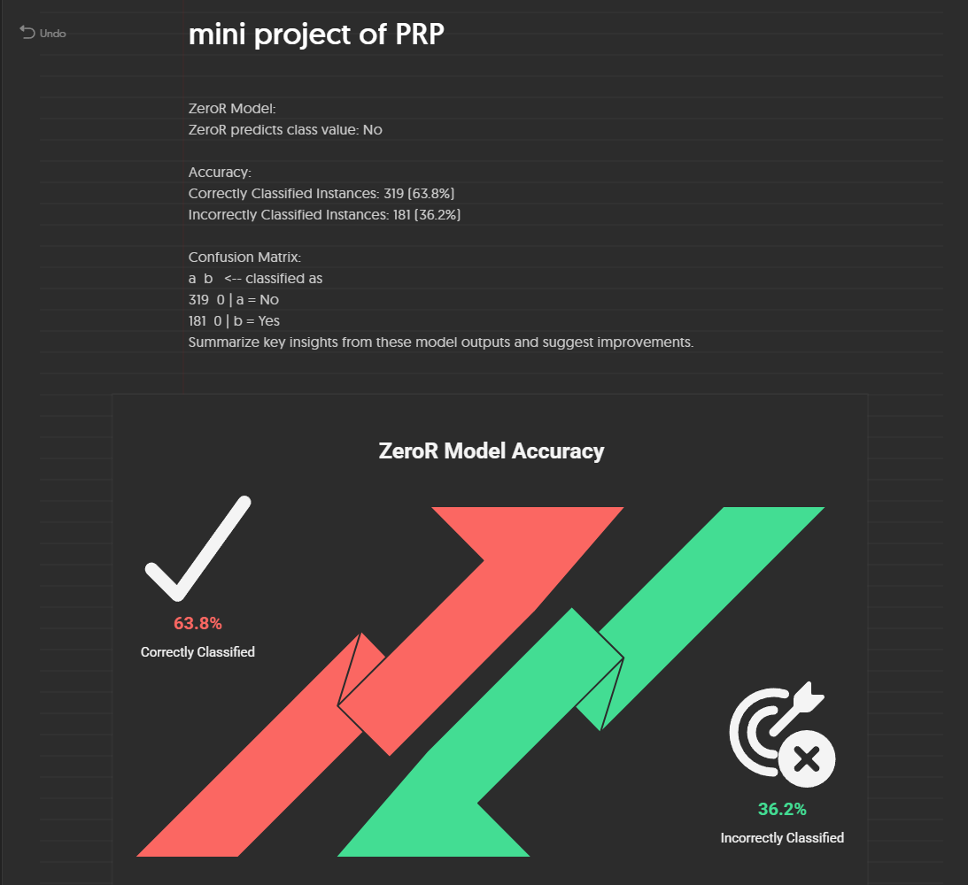

Slide 16
Reflection Questions:
Q1. Which attributes were most important for attrition?
:- Job Satisfaction, Over Time, and Years Since Last Promotion were the most important attributes influencing employee attrition. Employees with low job satisfaction and high overtime showed a higher tendency to leave. Lack of promotions also contributed to dissatisfaction and increased attrition risk.
Q2. Was your model overfitting or underfitting? Why?
:- The J48 decision tree showed signs of overfitting when model complexity increased, as it created a large tree but did not significantly improve cross-validation accuracy. The ZeroR model demonstrated underfitting since it predicted only the majority class and failed to learn meaningful patterns from the data.

Slide 17
Q3. What data improvements could reduce errors?
:- Model performance can be improved by adding more relevant features such as employee engagement, manager feedback, and work environment factors. Additionally, balancing the dataset and removing irrelevant features like Employee ID can help reduce prediction errors.
Q4. How should HR teams use this model in decision-making?
:-HR teams should use this model as a decision-support tool rather than relying on it completely. It can help identify employees at high risk of attrition, allowing HR to take preventive actions such as improving job satisfaction, reducing overtime, and offering timely promotions.

Slide 18
Conclusion:
This project demonstrated an end-to-end machine learning workflow for predicting employee attrition using Weka. The analysis showed that factors such as job satisfaction, overtime, and lack of promotions significantly influence employee attrition.
The J48 decision tree model helped identify patterns in the data, but its performance indicated limitations due to possible overfitting and weak feature relationships. The ZeroR model served as a baseline, highlighting that the dataset has limited predictive strength.
Overall, this project shows that machine learning can support HR decision-making by identifying high-risk employees. However, the model should be used as a decision-support tool alongside human judgment for effective workforce management.

Slide 19
Thank you
Name : Rahul Kumar
Roll : B24BS2271

